Slide 1
2017 Regional Sales Analysis
Budget Comparison, and Strategic Insights
Joelle Robinson
2025 Data Analytics with AI Bootcamp

Slide 2
Problem Statement
Problem:
Sales teams often lack a clear, data-driven understanding of regional performance, making it difficult to identify growth opportunities and optimize resources.
Project aims:
Analyse and visualize regional sales data to uncover trends
Evaluate profitability
Support strategic decision-making.

Slide 3
Project Steps
Step 1
Step 2
Step 3
Data processing
Collected, processed and cleaned sales data across a 5 year period from 2014 to 2018
Exploratory Data Analysis
Conduct analysis using Python
Create visualizations to emphasize trends
Recommendations
Give recommendations based on exploratory data analysis

Slide 4
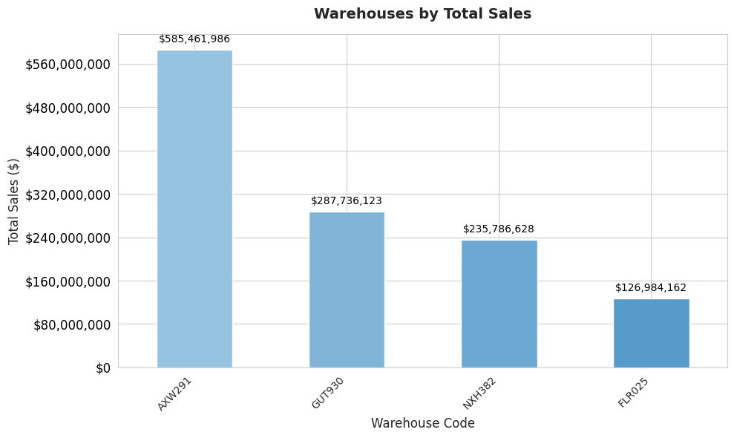

Slide 5
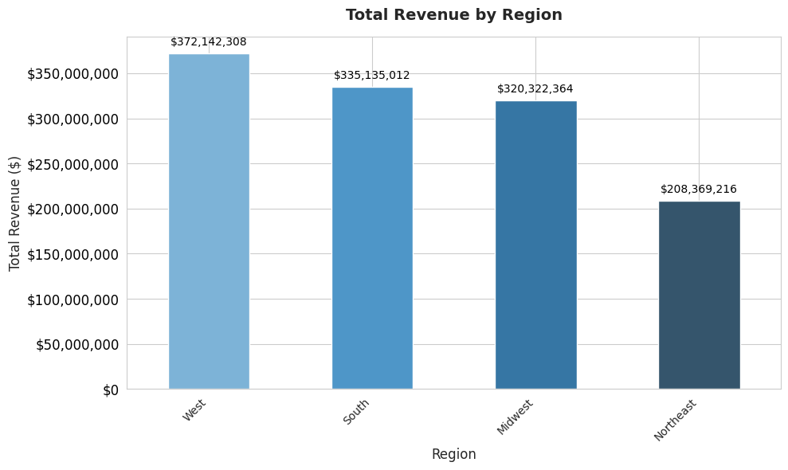

Slide 6
Total Revenue By Region
West
Makes up ~30% of revenue
South
Makes up ~27% of revenue
Midwest
Makes up ~26% of revenue
Northeast
Makes up ~17% of revenue

Slide 7
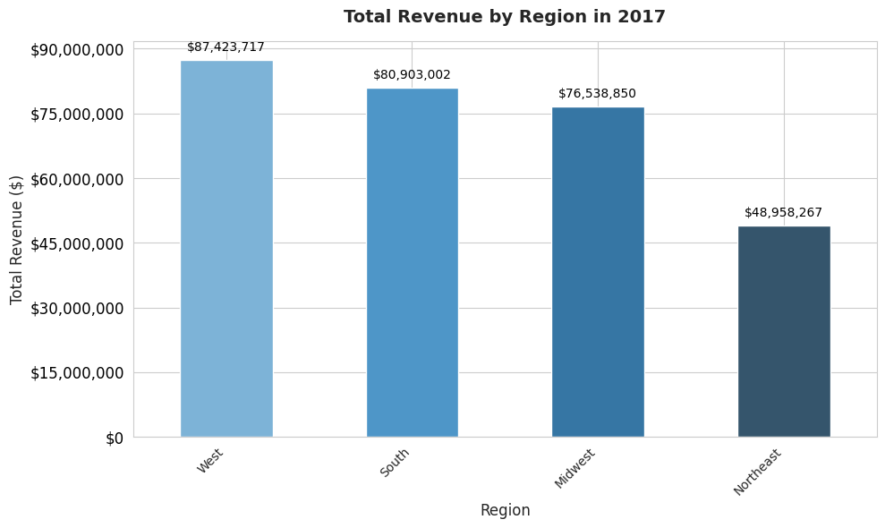

Slide 8
Total Revenue By Region in 2017
West
Makes up ~30% of revenue
South
Makes up ~28% of revenue
Midwest
Makes up ~26% of revenue
Northeast
Makes up ~17% of revenue
Revenue by region is consistent in 2017 from what was seen in other years.

Slide 9
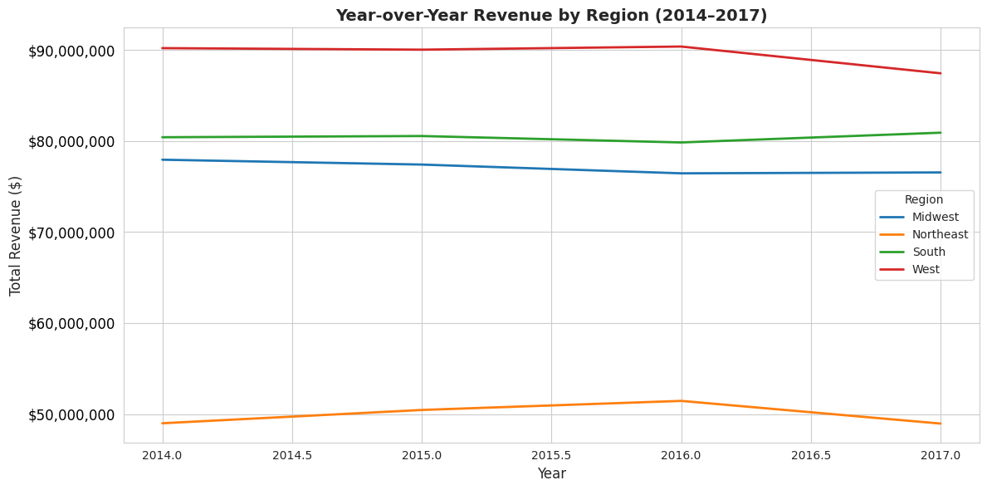

Slide 10
Year-over-Year Revenue By Region
West
Makes up ~30% of revenue
South
Makes up ~28% of revenue
Midwest
Makes up ~26% of revenue
Northeast
Makes up ~17% of revenue
Revenue by region is consistent in 2017 from what was seen in other years.

Slide 11
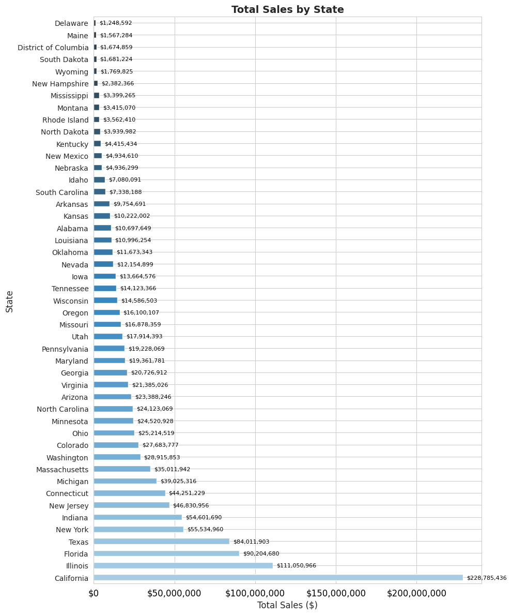
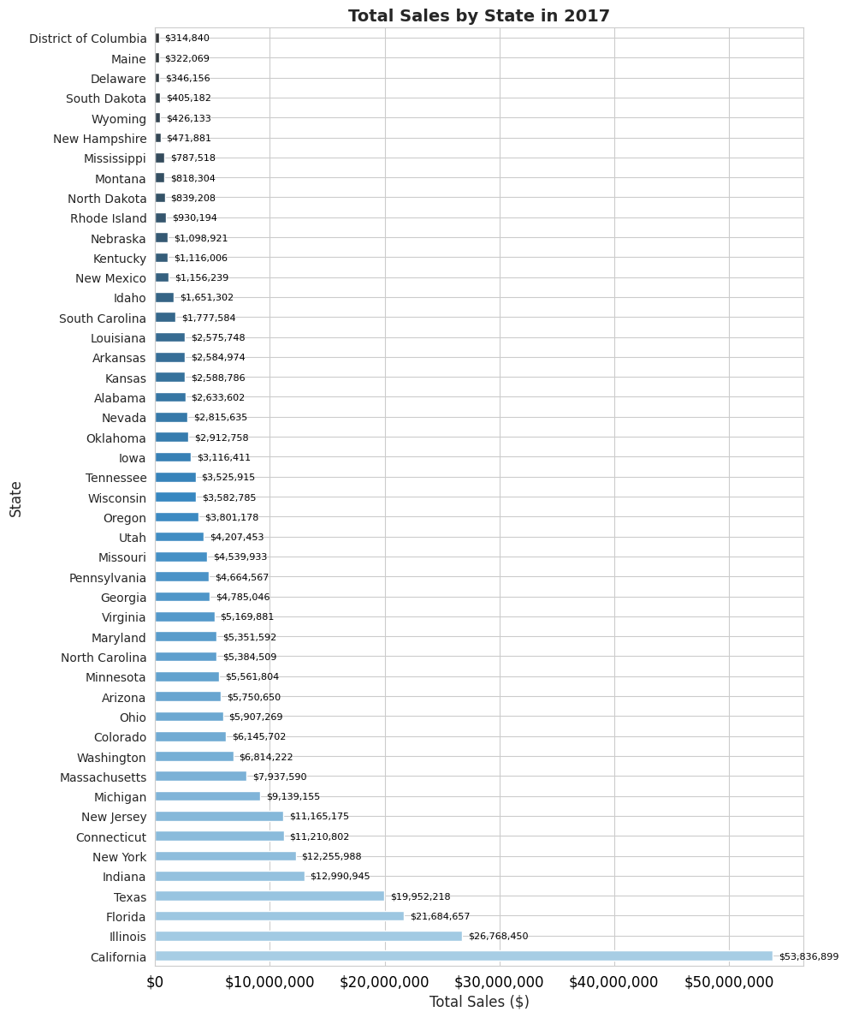

Slide 12
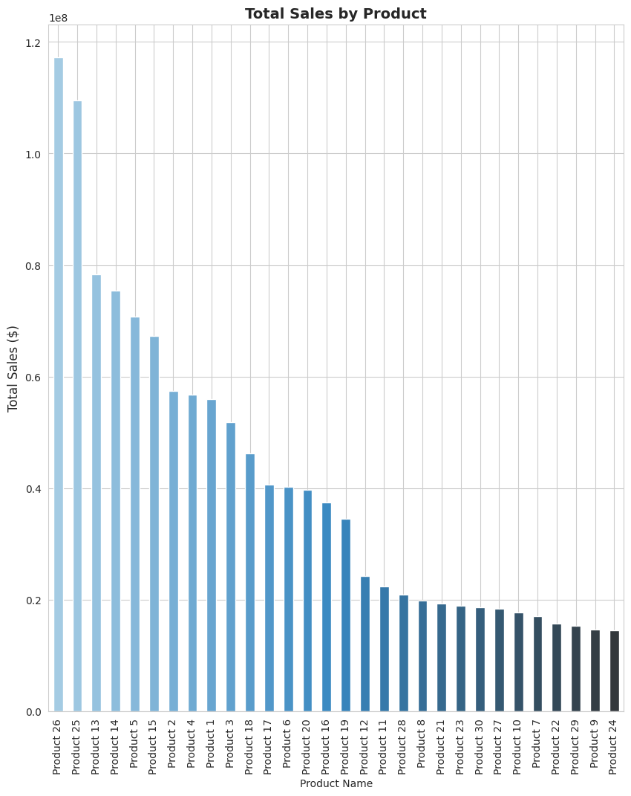
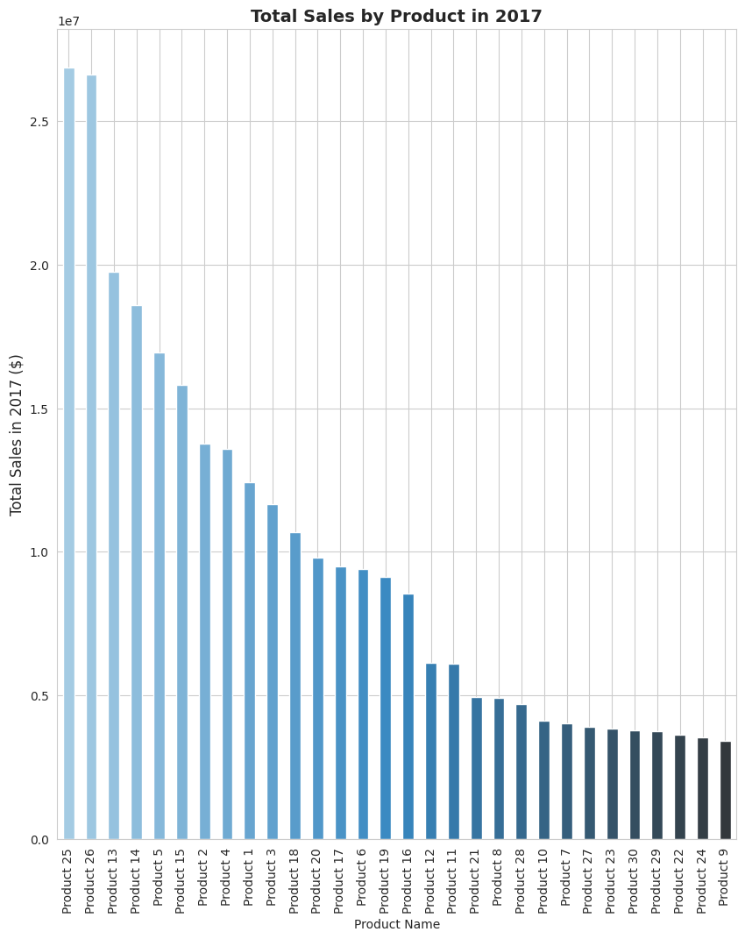

Slide 13
Total Revenue By Region in 2017
West
Makes up ~30% of revenue
South
Makes up ~28% of revenue
Midwest
Makes up ~26% of revenue
Northeast
Makes up ~17% of revenue
Revenue by region is consistent in 2017 from what was seen in other years.

Slide 14
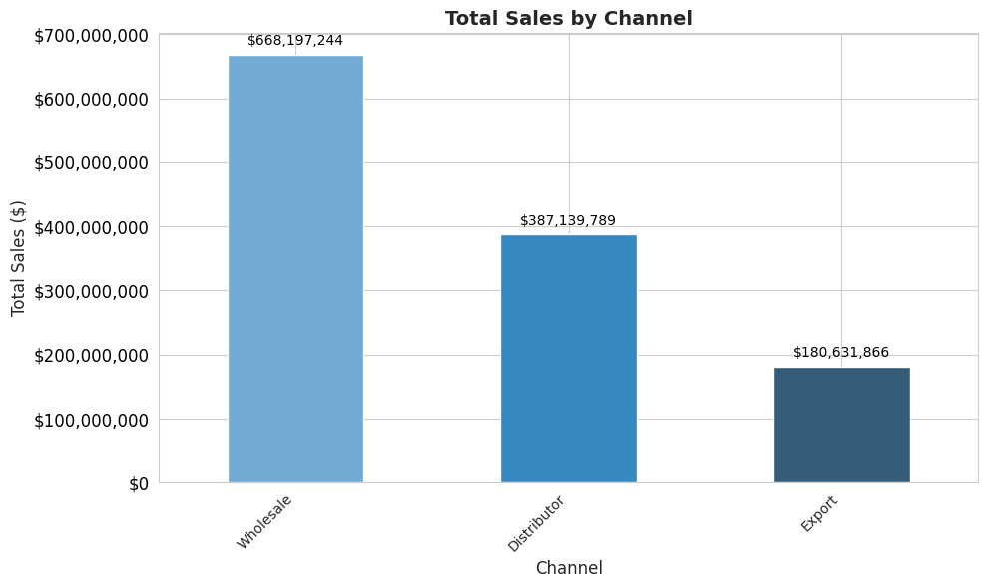

Slide 15
Total Sales By Channel
Wholesale
Makes up ~54% of sales
Distributer
Makes up ~31% of sales
Export
Makes up ~15% of revenue

Slide 16
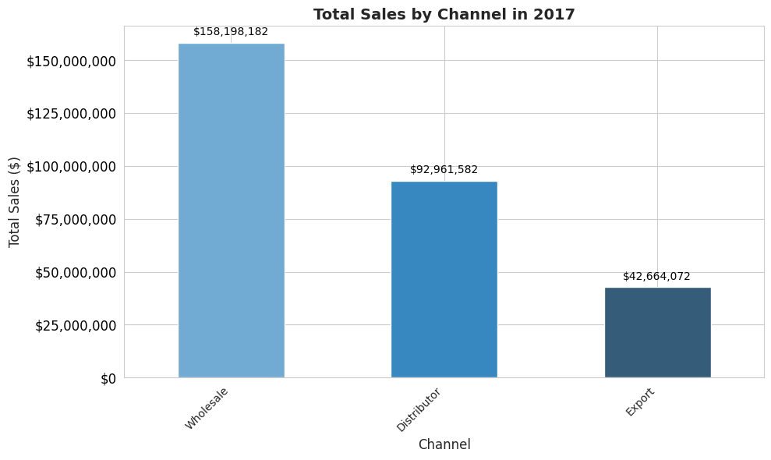

Slide 17
Total Sales By Channel in 2017
Wholesale
Makes up ~54% of sales
Distributer
Makes up ~32% of sales
Export
Makes up ~15% of revenue

Slide 18
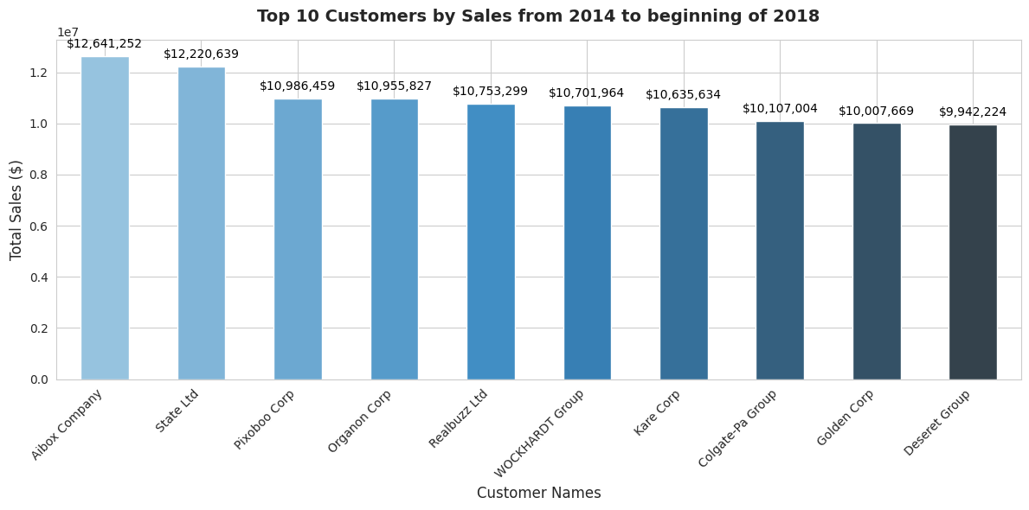

Slide 19
Top 10
The Top 10 customers make up 8.82% of sales

Slide 20
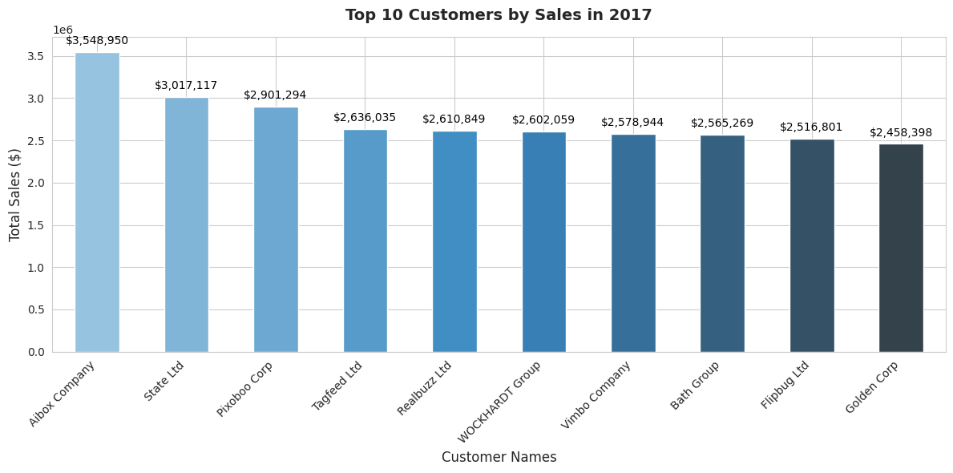

Slide 21
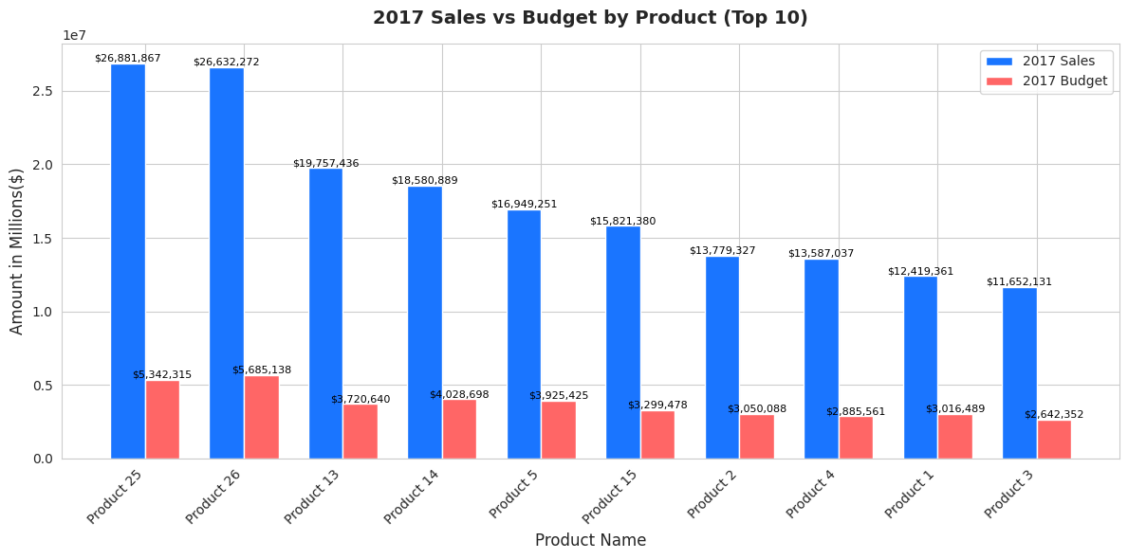

Slide 22
